Slide 1
CCD-KIT MEG Workshop:
Hands-on session
Wei He & Robert Seymour
2017-12-06

Slide 2

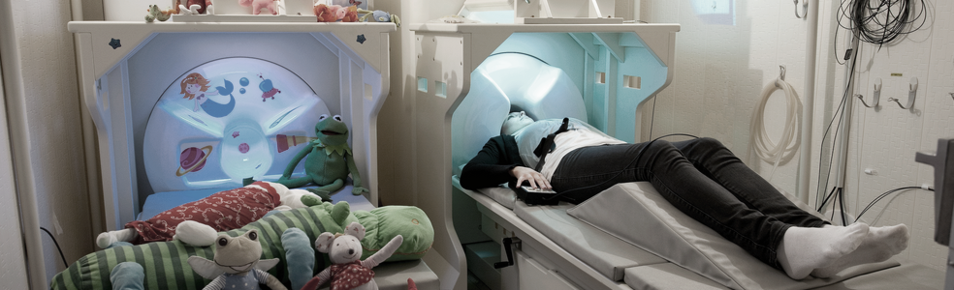
Background
Fieldtrip: http://www.fieldtriptoolbox.org
https://github.com/fieldtrip/fieldtrip
Whole brain connectivity and network analysis: http://www.fieldtriptoolbox.org/tutorial/networkanalysis
5 min eyes-closed MEG data collected at the KIT-Macquarie Brain Research (MEG) Laboratory
- sampled at 1000 Hz
- 160 axial gradiometers MEG

Slide 3
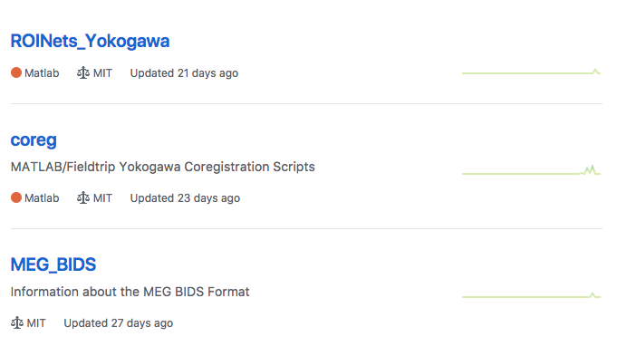
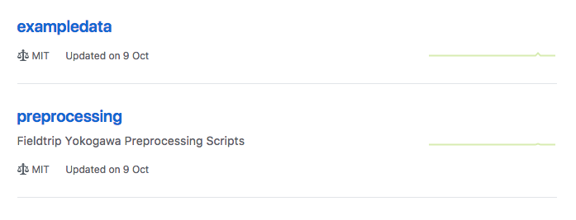
KIT-Macquarie Brain Research (MEG) Laboratory
A public repository for MEG data analysis scripts, designed for data acquired from the KIT-Macquarie Brain Research (MEG) Laboratory
https://github.com/Macquarie-MEG-Research
git clone https://github.com/Macquarie-MEG-Research/CCD_MEG_demo
Notes:
Code for this tutorial can be found on Github, alongside other useful code used for analysing MEG data acquired from the Yokogawa system with Fieldtrip and custom MATLAB code
Part of our attempt to make analysis open
Please download, contribute and comment!

Slide 4
1. Add Fieldtrip to your MATLAB path addpath(‘Users/Shared/Workshop/fieldtrip-20171128’)
2. Copy the CCD_MEG_demo folder to your desktop
(Finder → Preferences → Hard disks) → Users/Shared/Workshop
3. Change the MATLAB current directory to this folder e.g.
cd(’/Users/Guest/Desktop/CCD_MEG_demo’)
4. Type ft_defaults

Slide 5
Background
% Contents:
% - Step-0 : set-up
% - Step-1 : read the continuous data, segment into 2 seconds epochs
% - Step-2 : downsample the data to speed up component analysis
% - Step-3 : use ICA in order to identify cardiac and blink components
% - Step-4 : compute the power spectrum
% - Step-5 : compute the forward model
% - Step-6 : source reconstruction
% - Step-7 : create a pseudo-contrast based on a median split of the epoch
% - Step-8 : source reconstruction of the low-high alpha spectral data
% - Step-9 : connectivity analysis
% - Step-10 : network analysis

Slide 6
Background
dataout = functionname(cfg, datain, …)
functionname(cfg, datain, …)
Data structure:
datapow =
label: {160x1 cell}
dimord: 'chan_freq'
freq: [1x101 double]
powspctrm: [160x101 double]
grad: [1x1 struct]
cfg: [1x1 struct]
Data matrix dimension

Slide 7
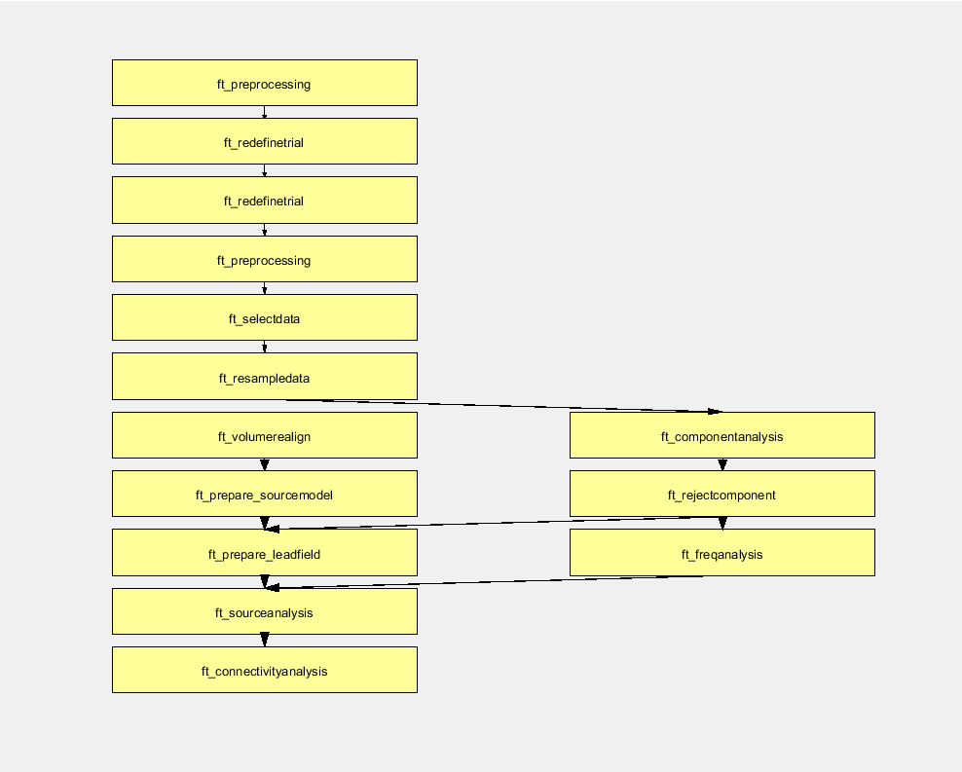
Background
Keep track of your analysis
output = ft_analysispipeline(cfg,source_conn)
cfg =[]
is a good practice
input cfg structure specifies parameters
output cfg structure keeps history but not data

Slide 8
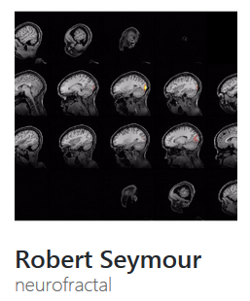
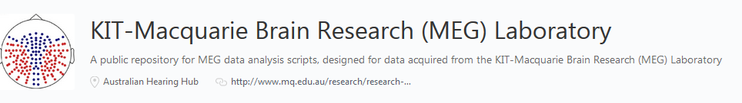
Background
MEG and MRI head coordinate systems
Different MEG MRI systems have different native head coordinate systems
All geometric data (MEG, MRI, head model, source model etc.) need to be expressed in the same coordinate system and with the same physical units (e.g. mm or cm) in fieldtrip
ft_transform_geometry
Transform sensor, head shape, head model etc.

Slide 9
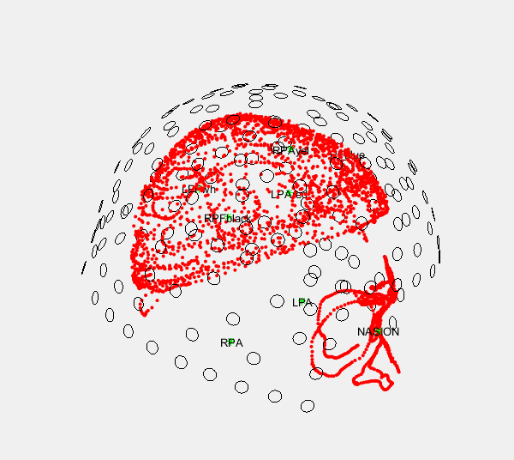
Reading and preprocessing MEG data
Step-0.1: Visualising the MEG and head shape coregistration
O = MEG sensor locations
. = points of the head shape from Polhemus

Slide 10
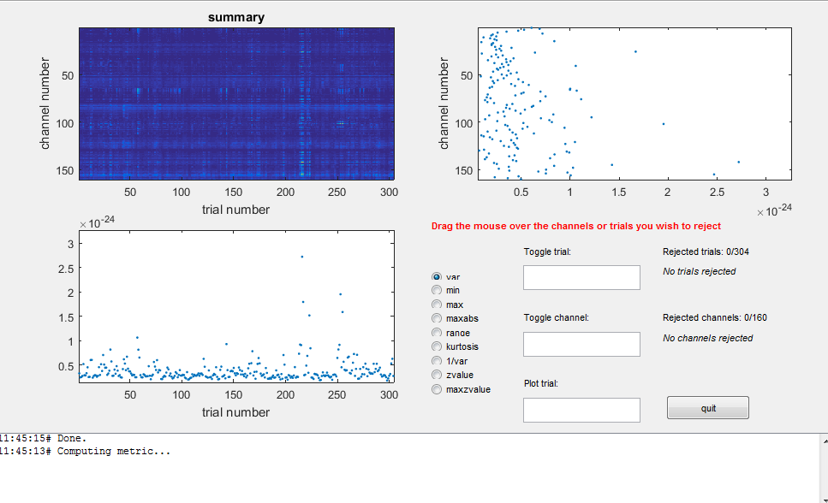
Reading and preprocessing MEG data
ft_rejectvisual
clean bad trials and/or bad channels
works only for segmented data
Further reading:
http://www.fieldtriptoolbox.org/tutorial/artifacts
http://www.fieldtriptoolbox.org/tutorial/visual_artifact_rejection

Slide 11
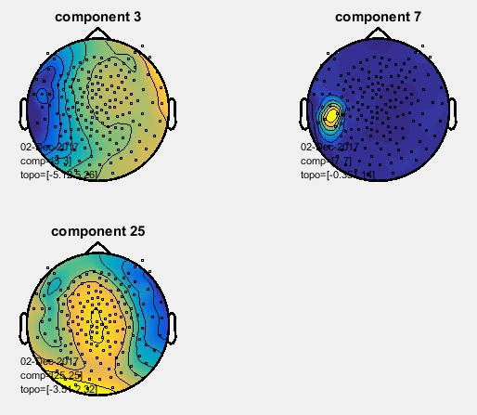
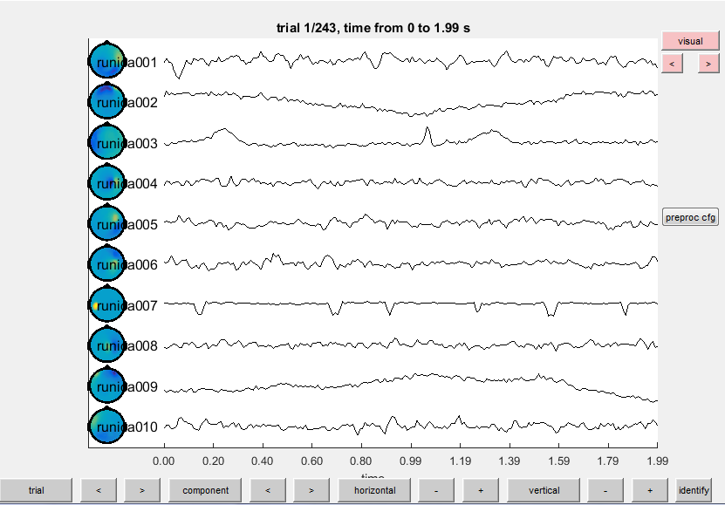
Reading and preprocessing MEG data
ft_componentanalysis
identify occular and cardiac artifacts
ft_topoplotIC
ft_databrowser

Slide 12
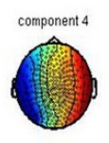
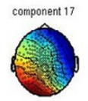
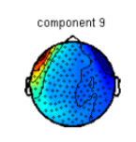
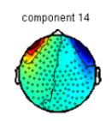
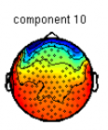
Reading and preprocessing MEG data
ECG
should normally come within the first 20-30 components as they are very regular and salient signal
almost always get 2 ECG components that look similar to each other, but slightly rotated
EOG
should also come within the first 20 components but topology would vary
Further reading:
http://www.fieldtriptoolbox.org/example/use_independent_component_analysis_ica_to_remove_ecg_artifacts
http://www.fieldtriptoolbox.org/example/use_independent_component_analysis_ica_to_remove_eog_artifacts

Slide 13
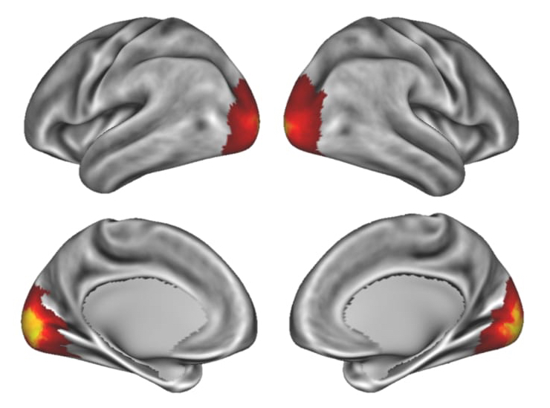
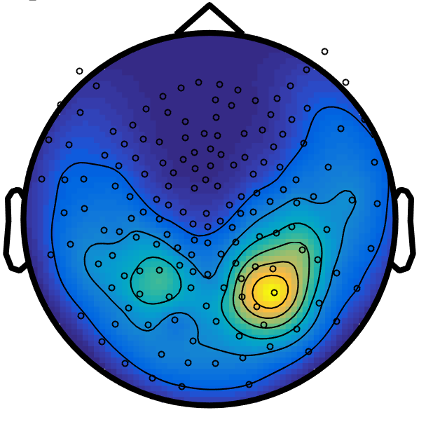
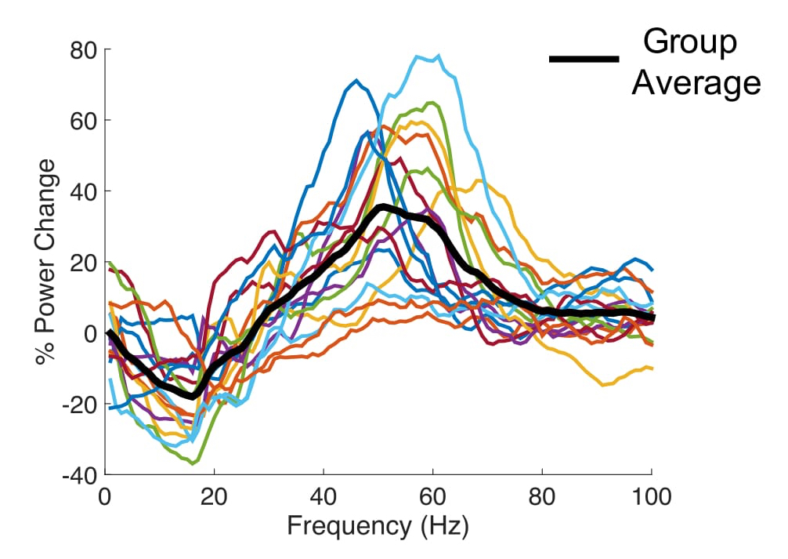
Spectral and source analysis
CCD-KIT MEG Workshop
6th Dec 2017
Robert Seymour (robert.seymour@students.mq.edu.au)

Slide 14
KIT-Macquarie Brain Research (MEG) Laboratory
A public repository for MEG data analysis scripts, designed for data acquired from the KIT-Macquarie Brain Research (MEG) Laboratory
https://github.com/Macquarie-MEG-Research
git clone https://github.com/Macquarie-MEG-Research/fieldtrip_workshop_2017
Notes:
Code for this tutorial can be found on Github, alongside other useful code used for analysing MEG data acquired from the Yokogawa system with Fieldtrip and custom MATLAB code
Part of our attempt to make analysis open
Please download, contribute and comment!

Slide 15
Alpha
Idling rhythm (8-13Hz)
Now viewed as active inhibition or stabilising brain function
To investigate alpha we need to transform our data to the FREQUENCY domain
An early EEG recording performed by Hans Berger.
Arrow = offset of mental arithmatic task
(Niedermeyer, 1997)
Clayton, M. S., Yeung, N., & Cohen Kadosh, R. (2017). The many characters of visual alpha oscillations. European Journal of Neuroscience.
Notes:
The main aim of our tutorial today is to map the power and connectivity of resting-alpha. Alpha-band oscillations = 8-13Hz
This is an original recording from Hans Berger - when the participant stops doing a there is an increase in
Now alpha is viewed as an oscillation responsible for active inhibition or stablilisation of a brain region. For more information on this see excellent 2017 review.
To investigate alpha in our clean MEG data we need to transform into the frequency domain

Slide 16
ft_freqanalysis
cfg = [];
cfg.output = 'pow';
cfg.method = 'mtmfft';
cfg.taper = 'dpss';
cfg.tapsmofrq = 1;
cfg.keeptrials = 'no';
datapow = ft_freqanalysis(cfg, dataica);
Multitaper Method
Discrete Prolate Spheroidal Sequences
Amount of spectral smoothing (in Hz)
http://www.fieldtriptoolbox.org/reference/ft_freqanalysis
Notes:
To transform into the frequency domain we use the Fieldtrip function ft_freqanalysis
We are interested in obtaining information about frequency power
The main options to be aware of:
cfg.method: multi-taper method (other options: wavelet, MVAR models)
cfg.taper: we are using DPSS taper (other main option is Hanning)
cfg.tapsmofrq: amount of frequency smoothing

Slide 17
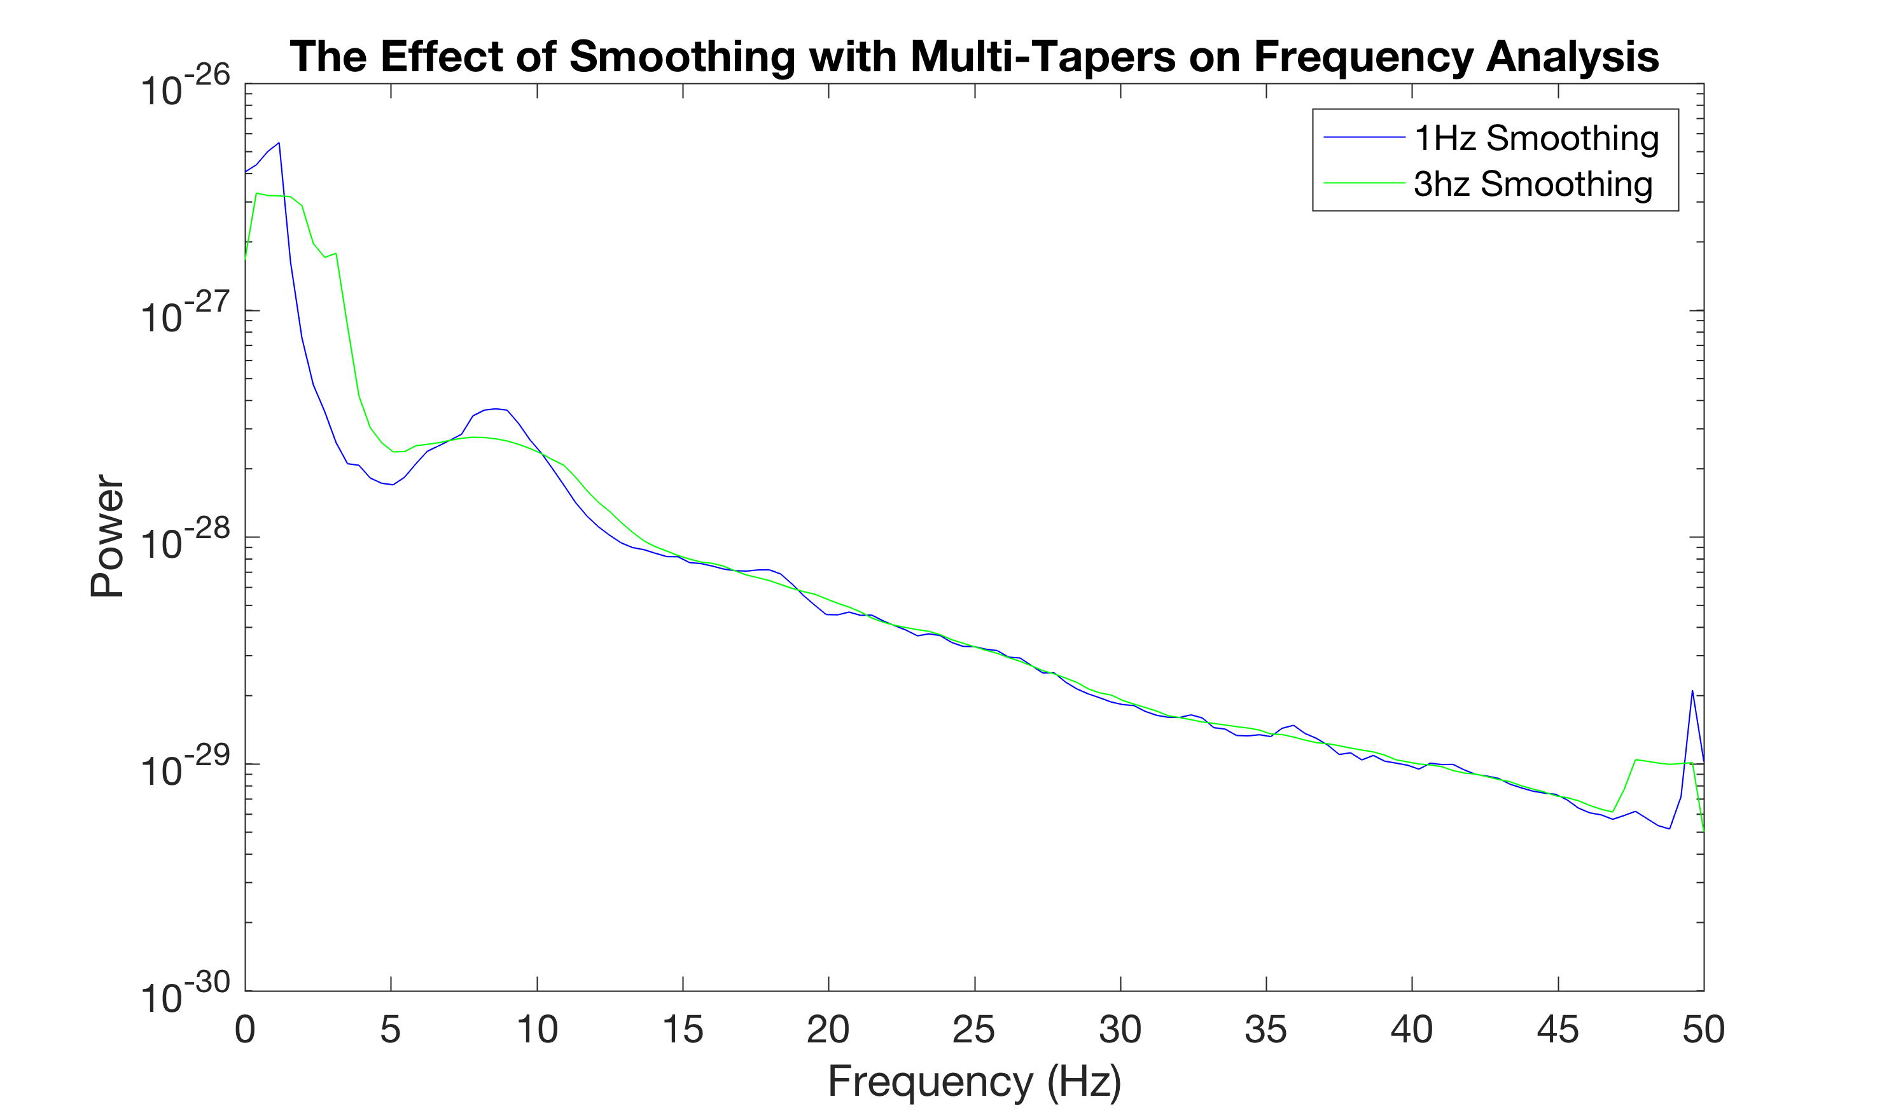
Multi-Taper Methods
Average the spectral power over several orthogonal tapers
The more tapers = the more smoothing
This smoothing mainly helps estimate high-frequency power estimation (not low-frequency) = we’re sticking with 1Hz
Jarvis, M. R., & Mitra, P. P. (2001). Sampling properties of the spectrum and coherency of sequences of action potentials. Neural Computation, 13(4), 717-749.
Notes:
For those not aware, mutli-taper methods involve averaging estimates of spectral power over several orthoganal tapers
The more tapers applied to the data = more smoothing (efficient way to control spectral smoothing)
But how much smoothing is good smoothing? Here is a graph to show the effects in our data. See the line in green (3Hz) smoothing is a lot flatter than the blue line (1Hz), but is less able to estimate 10Hz alpha.
Smoothing mainly helps the estimation of high frequency power, but not low frequency where changes in brain oscillations are constrained to much smaller frequency changes. Therefore we’ll stick with 1Hz smoothing.

Slide 18
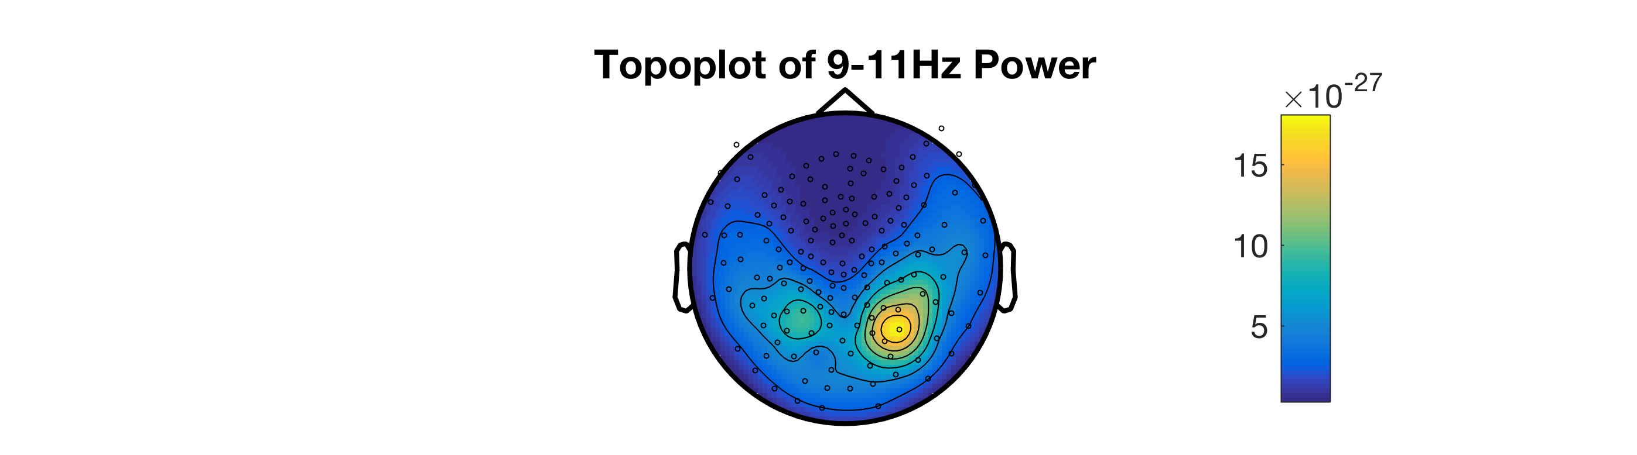
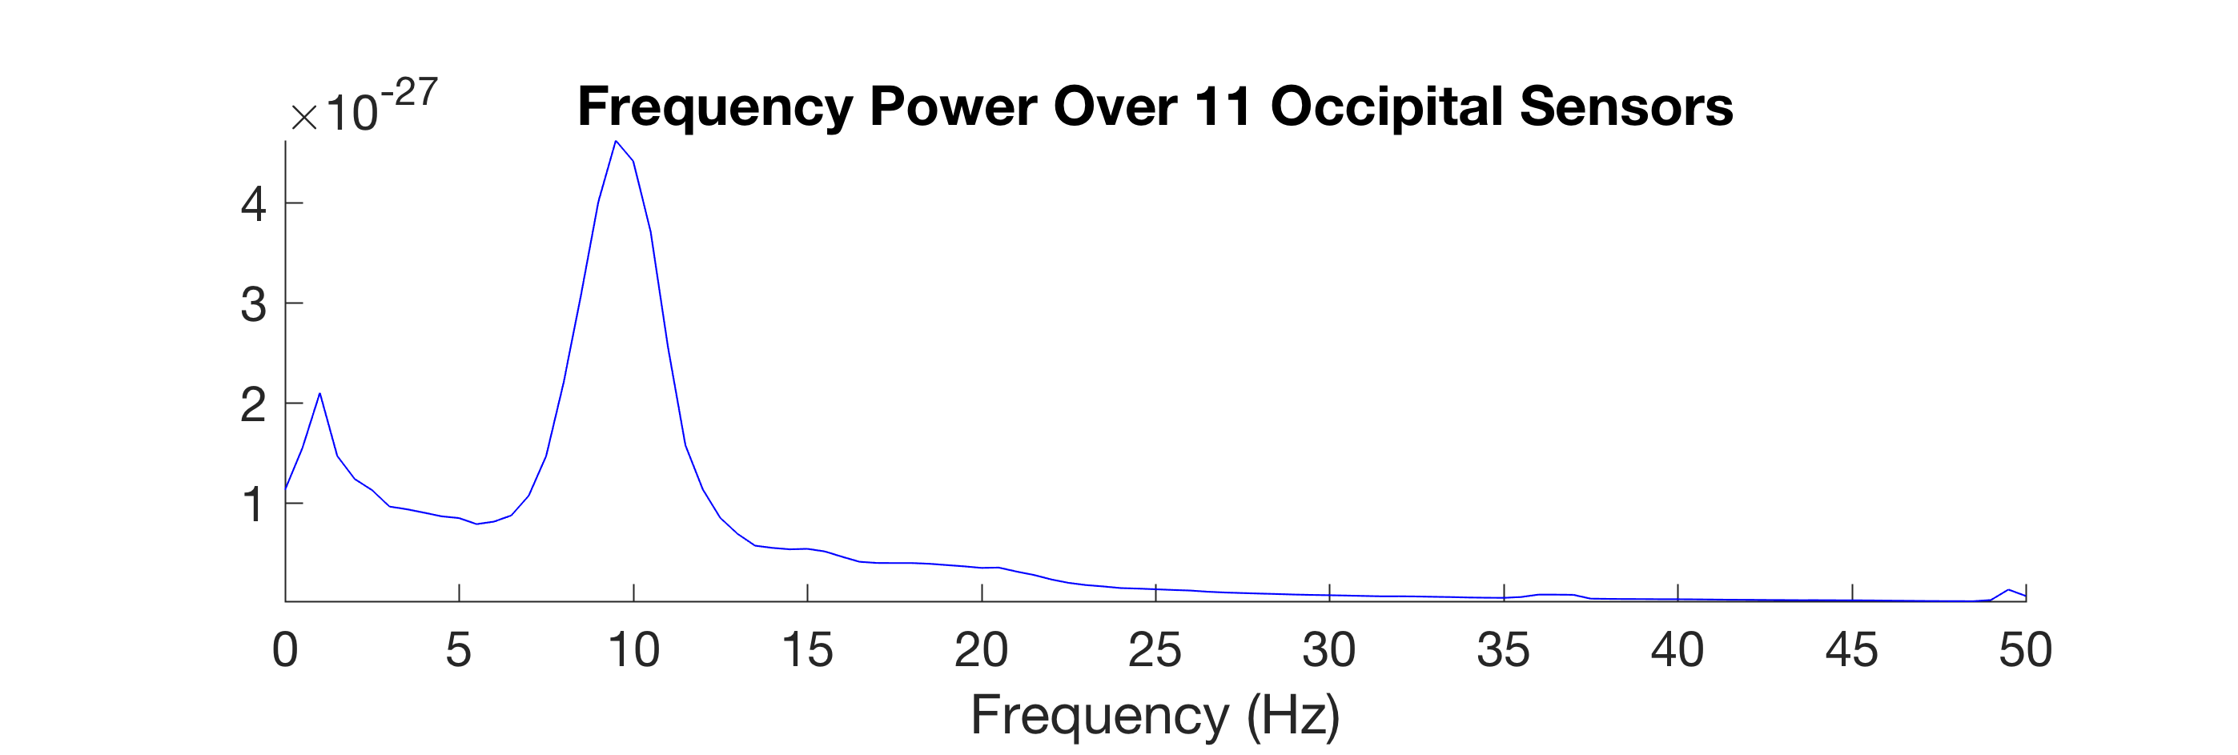
ft_topoplotER
ft_singleplotER
Notes:
Running the code and visualising alpha (9-11Hz) in a topoplot (ft_topoplotER) shows that the back of the head over occipital cortex
Because we are using axial gradiometers the true location of the source will be somewhere in the middle of these dipoles
Plotting the power spectrum (ft_singleplotER) over 11 occipital sensors gives a classic peak at 10Hz (alpha!)
We’ve mapped resting-alpha power at the sensor level.. But where is this alpha ‘coming from’?

Slide 19
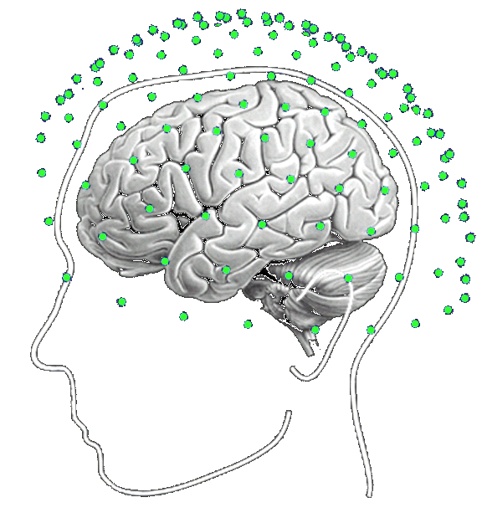
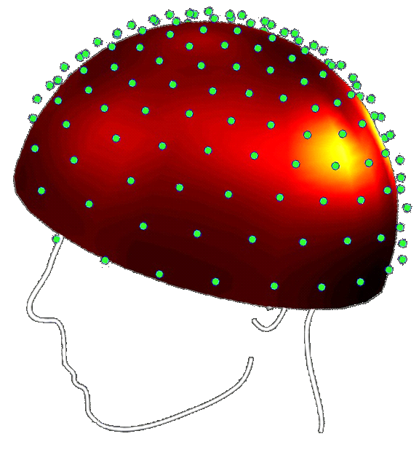
The Inverse Problem
Forward problem = well posed
The inverse problem cannot be solved but accurately estimated given prior knowledge
Inverse Problem =
ill posed
EEG/MEG data
Post-synaptic Potentials (pyramidal neurons)
Notes:
To answer this we need to talk about the inverse problem
The forward problem involves starting out with a pattern of brain activity produces a specific pattern of MEG at the sensor-level. We can accurately describe this
However if we start off with only the sensor-level MEG data and want to map know the pattern of post-synaptic potentials or brain activitiy which gave rise to the data, there are many (infinite?) solutions. We can never solve this problem (few sensors to many neurons), but a solution can be accurately estimated given certain assumptions about the location of the brain within the helmet, the specific pattern of observed data and orientation of the sources

Slide 20
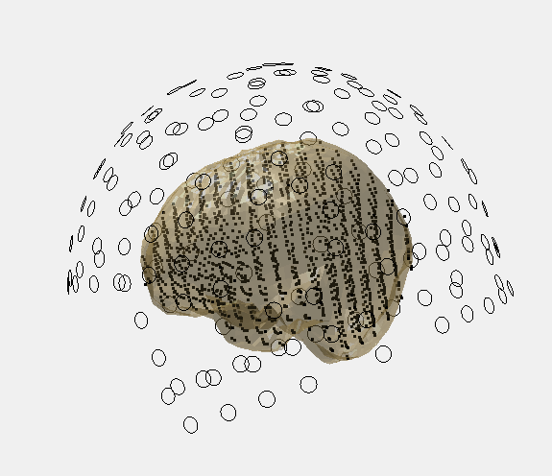
O = MEG sensor locations
. = points of the leadfield
For coregistration code please see:
https://github.com/Macquarie-MEG-Research/coreg
Notes:
We will compute a forward model like this: where the position of the sensors are described, a source model of the brain is created and equally spaced grid-points are placed within this source model
For this example we have performed the coregistration step for you –i.e. accurately working out where the head was in the MEG helmet using the 3 fiducials and head-shape information. Code for this can be found on Github.

Slide 21
ft_prepare_leadfield
“The forward solution is expressed as the leadfield matrix (Nchan*3), where each column corresponds [to] the potential or field distributions on all sensors for one of the x,y,z-orientations of the dipole.”
% compute the leadfield
cfg = [];
cfg.grad = grad_trans;
cfg.grid = sourcemodel;
cfg.headmodel = headmodel_singleshell;
cfg.reducerank = 2; % default for MEG is 2, for EEG is 3
% cfg.normalize ='yes';
cfg.channel = {'MEG'};
lf = ft_prepare_leadfield(cfg,dataica);
Gradiometer definition
Source model (1457 points inside)
Somewhat corrects for centre of head bias
Notes:
To create the forward model we ft_prepare_leadfield
A leadfield is a number of channel * 3 matrix where each column corresponds with the potential or field distributions on all sensors for one of the x,y,z-orientations of the dipole
The main options to be aware of:
cfg.grad = need variable describing the gradiometers
cfg.grid = need variable describing the sourcemodel (model of the brain
cfg.normalise = option to somewhat correct for the centre of the head bias. We have commented this out so you can correct for this bias post-hoc.

Slide 22
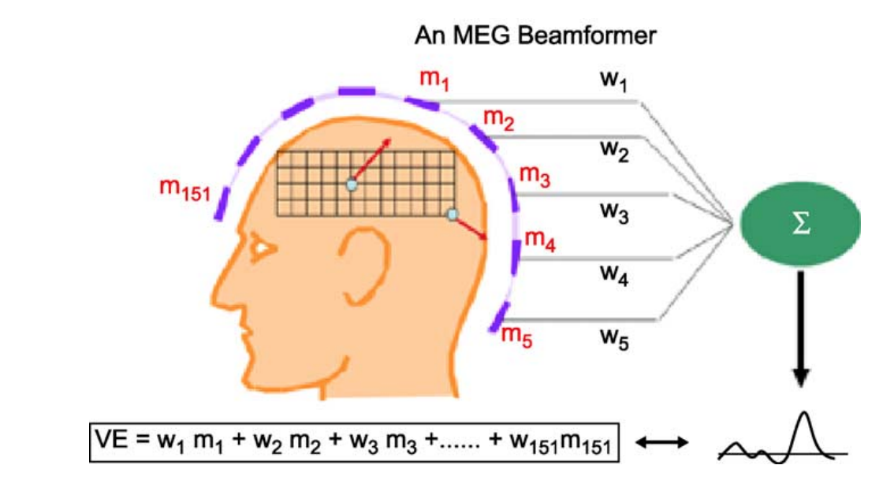
Beamformers
For each grid-point the data is multiplied by
a spatial filter which serves to maxmimise
signal from that location but attenuate activity from other locations
Advantages:
Operates on raw data sets (instead of averaged data sets)
Can be used to analyse induced brain activity
Do not need a-priori specification of the number of active sources
Excellent noise immunity –ocular / heart artefacts are projected out of the data
Not biased by superficial sources
Hillebrand, A., & Barnes, G. R. (2005). Beamformer analysis of MEG data. International review of neurobiology, 68, 149-171.
Notes:
- As Arjan described a beamformer involves creating a spatial filter for each point of our grid. This filter serves to maxmimise signal from that location but attenuate activity from other locations
- There are various advantages to beamformers (read)
- One of the advantages of Fieldtrip over other software is the robust implementation of beamformers

Slide 23
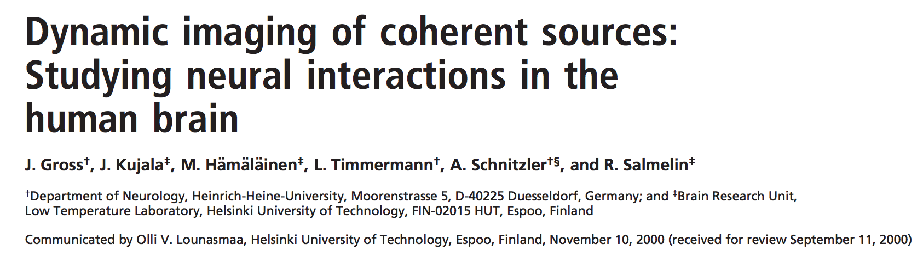
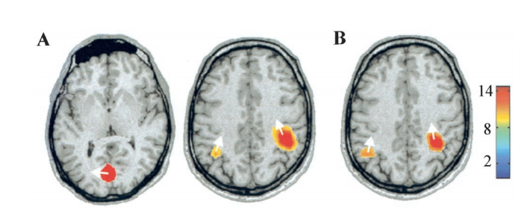
Source-localisation based on fourier-transformed data → cross spectral density. This can be cross-multipled by the spatial filter (Gross et al., 2001).
Notes:
To source localise our resting-state alpha data we can use a frequency-domain beamformer first described by Gross and colleagues in 2001
Essentially this involves fourier-transforming the data, creating a cross spectral density matrix and multiplying this by a spatial filter in the same way as for other beamformers
For more information on this read the Gross et al., 2001 paper

Slide 24
cfg = [];
cfg.method = 'mtmfft';
cfg.output = 'fourier';
cfg.keeptrials = 'yes';
cfg.tapsmofrq = 1;
cfg.foi = 10;
cfg.pad = 'nextpow2';
freq = ft_freqanalysis(cfg,dataica);
Here we are fourier-transforming our data for every trial at 10Hz
For more information on nextpow2 see:
https://au.mathworks.com/help/matlab/ref/nextpow2.html
Notes:
- These lines of code involve fourier-transforming our data for every trial at 10Hz

Slide 25
ft_sourceanalysis
cfg = [];
cfg.frequency = freq.freq;
cfg.method = 'pcc';
cfg.grid = lf;
cfg.headmodel = headmodel_singleshell;
cfg.keeptrials = 'yes';
cfg.pcc.lambda = '10%';
cfg.pcc.projectnoise = 'yes';
cfg.pcc.fixedori = 'yes';
source = ft_sourceanalysis(cfg, freq);
sourceInt = ft_sourcedescriptives([], source);
10Hz
Using fourier output to calculate CSD
Pre-computed leadfield
Regularisation parameter applied to CSD
Fixed orientation of sources
http://www.fieldtriptoolbox.org/reference/ft_sourceanalysis
Notes:
Can then use ft_sourceanalysis
Main options to be aware of:
cfg.frequency = frequency of interest (we can get the exact frequency from the output of the fourier transform)
cfg.method = beamformer which uses fourier output
cfg.grid = the pre-computed leadfield
cfg.lambda = amount of regularisation applied to the CSD matrix
cfg.fixedori = use a fixed orientation of sources for our later connectivity analysis

Slide 26
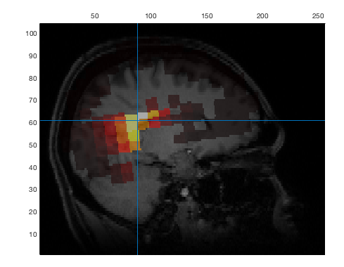
The activity is highest in the centre of the head?
Have we discovered a new way the brain works?!
…NO! Exercise 3 shows you how to correct for this
Notes:
Running this code and plotting the output (ft_sourceplot)
The activity seems to be in the centre of the head!
Is the participant using their ventricles to think? NO – beamformers are biased towards the centre of the head. A solution is dicussed in exercise 3.

Slide 27
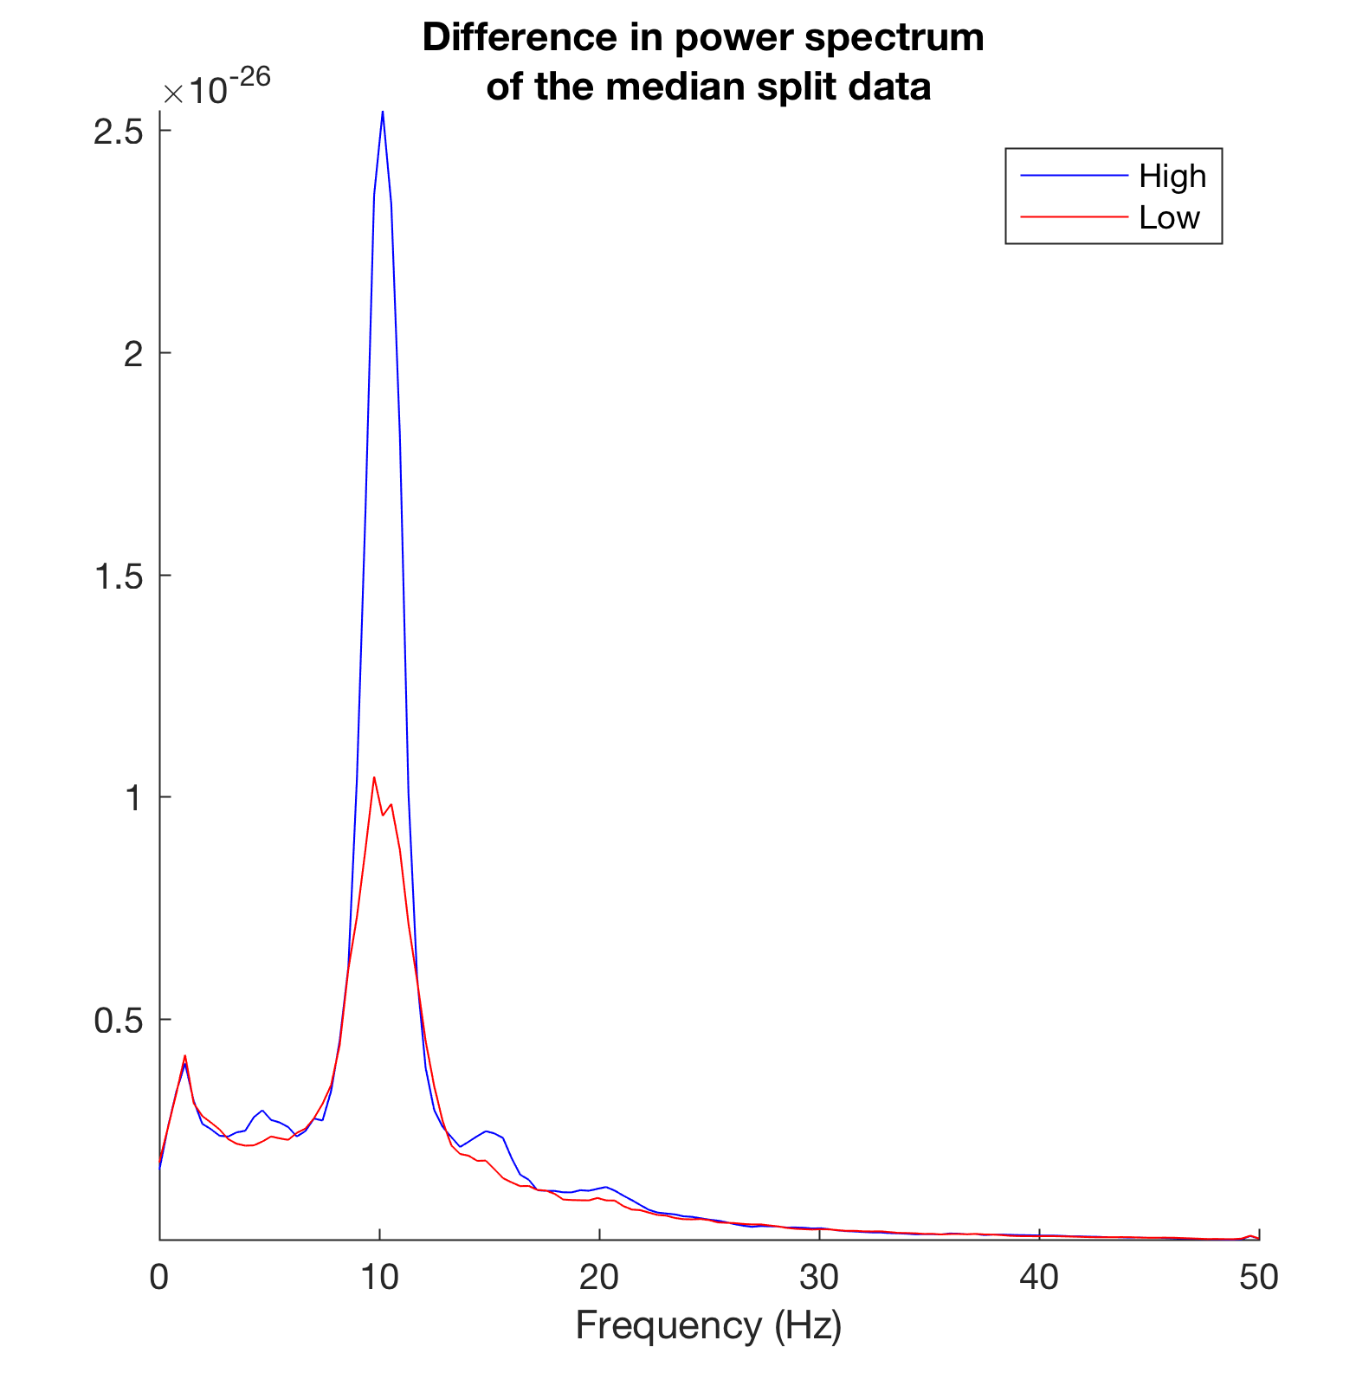
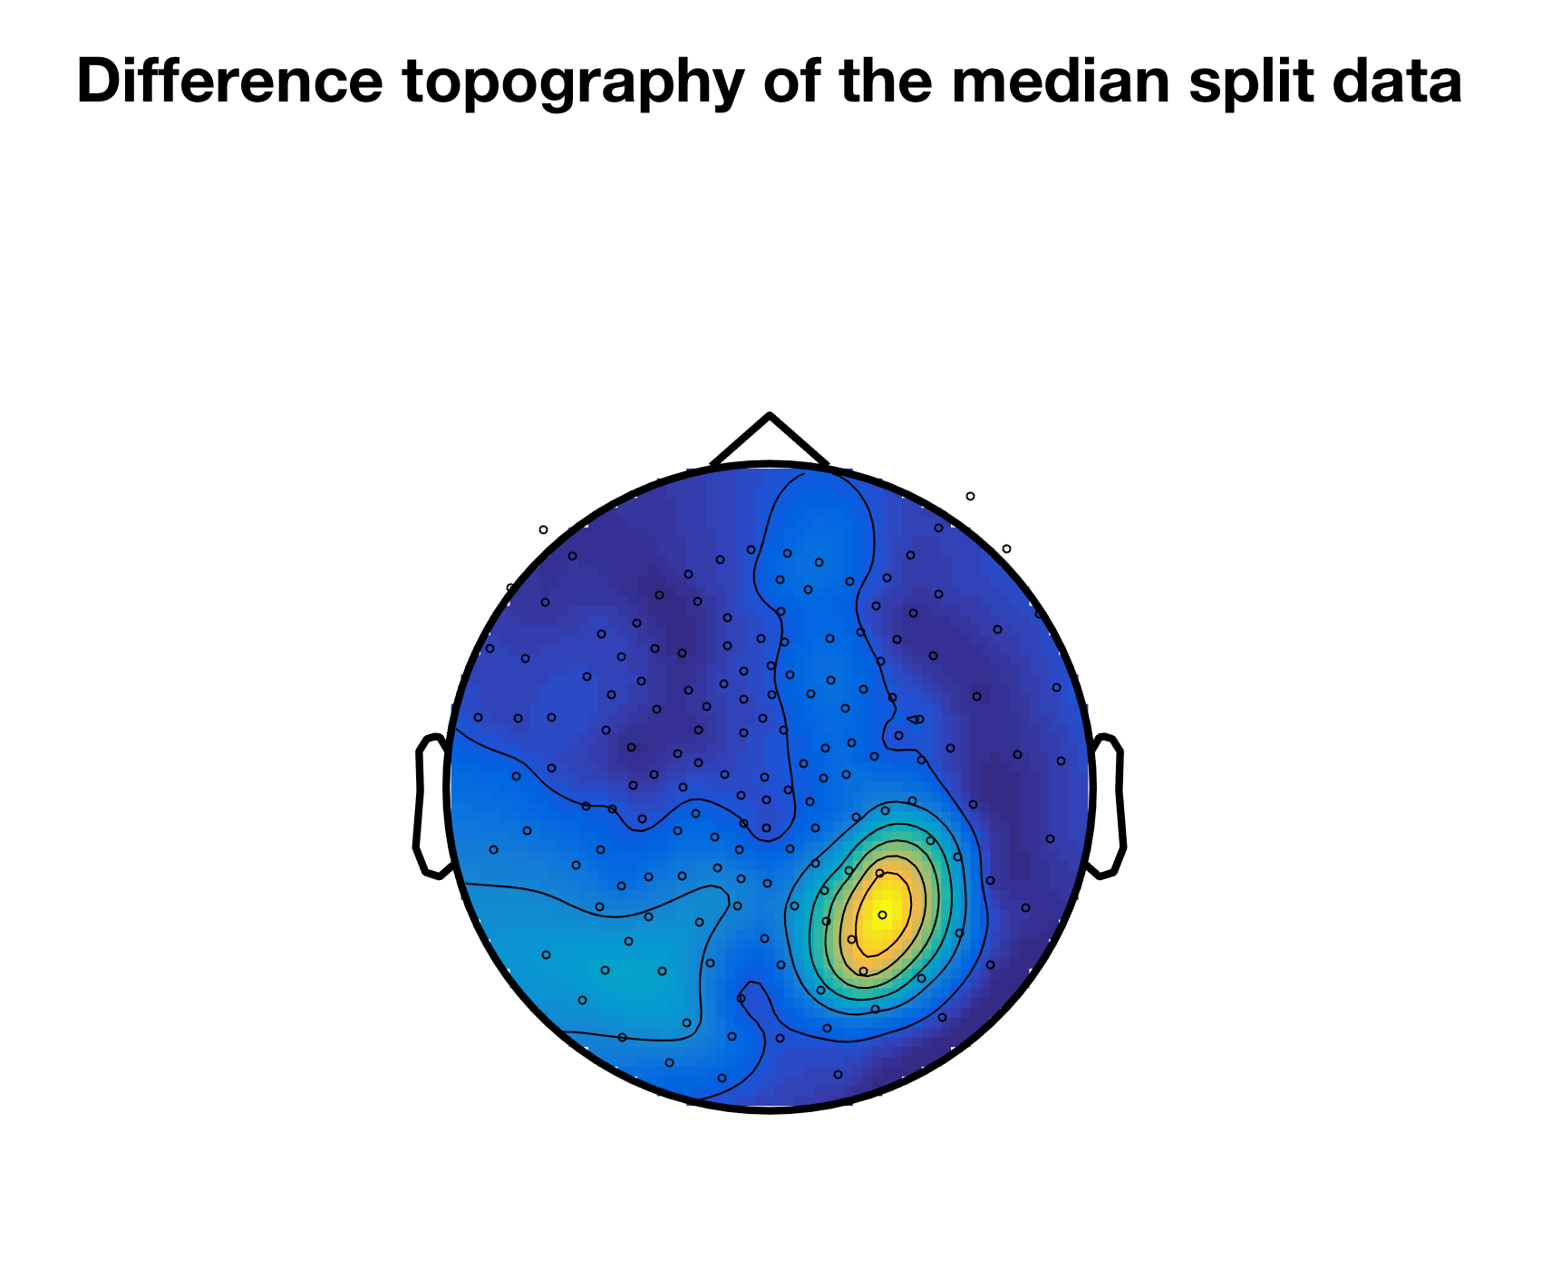
Complex Designs
Can make the analysis even more complicated by creating median split of high vs low alpha power trials
Notes:
- The tutorial talks you though more complex experimental design where we create a median split of trials based on high and low alpha power

Slide 28
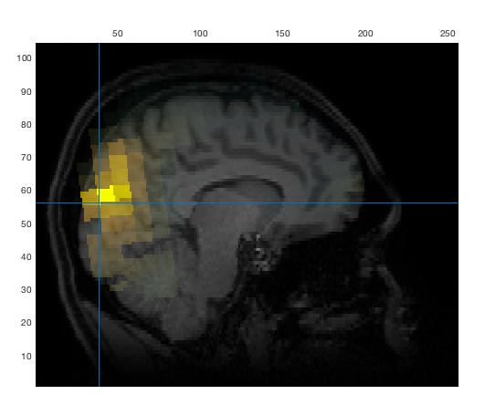
Your task is to compute the difference in power between high and low alpha trials in source-space
It is often crucial to have a common spatial filter between conditions
Notes:
Your task (tutorial guides you through this) is to compute the power difference between high and low alpha trials in source space
For this we use a common spatial filter over high and low trials, so we can be sure that differences in power are a result genuine and not simply due to differences between the two spatial filters used
For more complex paradigms creating a common spatial filter is crucial
Hopefully you should end up with a pretty picture like this(!)

Slide 29
Confused? Ask for help ☺
Happy source localising!
Many thanks to Klaus Kessler, Paul Sowman, Wei He, Jan-Mathijs Schoffelen and the Fieldtrip Development Team
Notes:
When running these steps please ask for help if you’re stuck or
Happy source localisaing and many thanks to my colleagues who have helped me learn about MEG analysis and gave me the chance to run this tutorial session

Slide 30
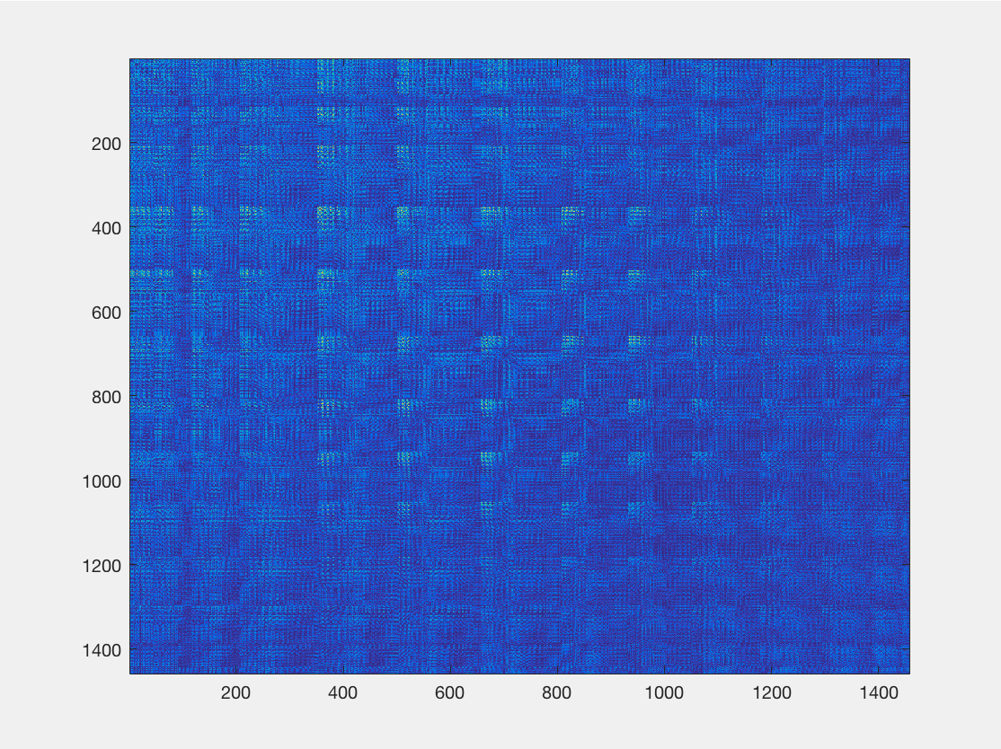
Connectivity analysis
cfg = [];
cfg.method ='coh';
cfg.complex = 'absimag';
figure;
imagesc(source_conn.cohspctrm(source_conn.inside, source_conn.inside));
coherence estimated from trial-wise spectrum from ‘pcc’
the imaginary part of the coherence spectrum
connectivity matrix between all pairs of dipole locations

Slide 31
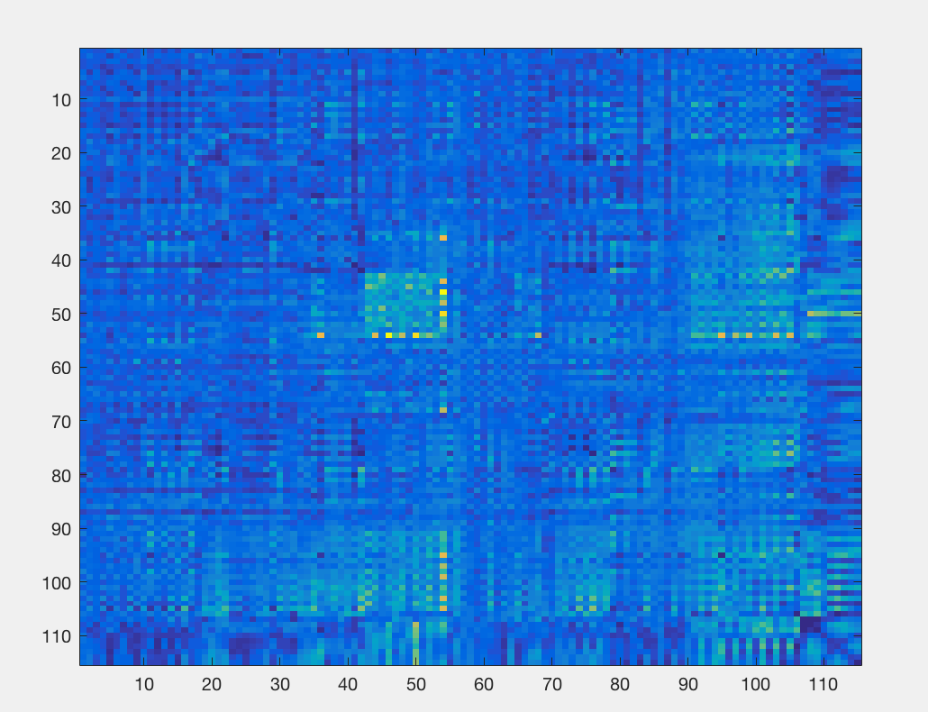
Connectivity analysis
We control for the source leakage by combing source values (i.e., connectivity measures here) between sets of dipole pairs that belong to a given pair of parcels defined based on anatomy – the parcellation scheme
connectivity matrix between all pairs of parcels

Slide 32
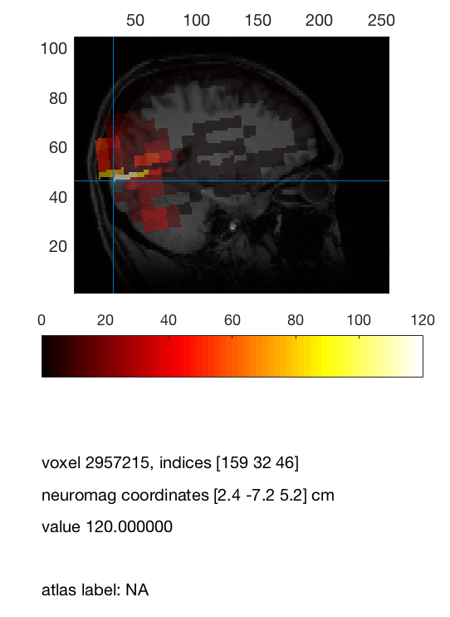
Network analysis
Undirected Degree
connectedness of a node/parcellated brain region
threshold is the most critical parameter and can be arbitrary
Try different threshold to see how results might differ?
Color coded node degree distribution based on imaginary part of coherency

Slide 33
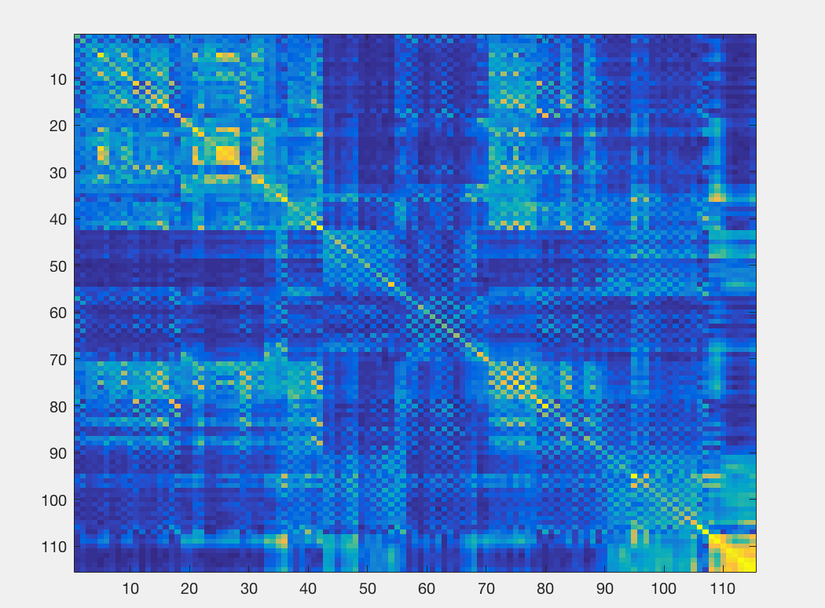
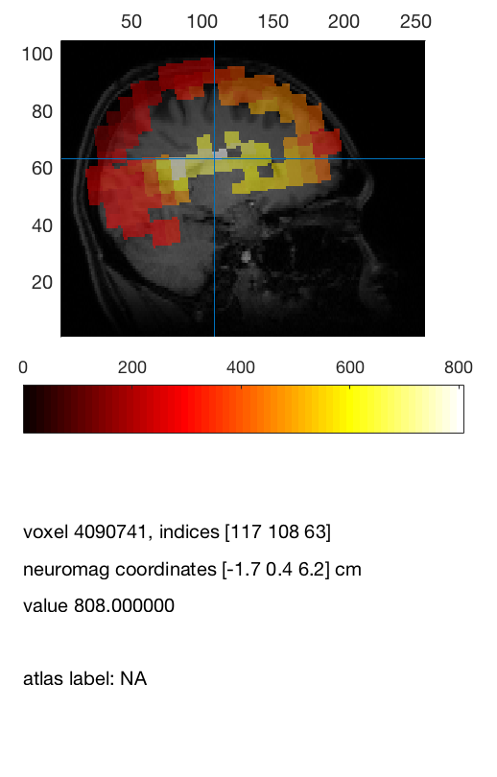
Connectivity analysis
plv connectivity matrix between all pairs of parcels

Slide 34

Many thanks to Robert and Paul. And please ask them questions ☺

